Slide 1

GROUP F – CAPSTONE PROJECT PRESENTATION
Online Shoppers Purchasing Intention Prediction
Submitted By:
Surbhi Bhatia
Siddharth Shankar
Rahul Das
Vaibhav Bhatnagar
Jalaj Tripathi
Mentored By:
Mr. Romil Gupta

Slide 2

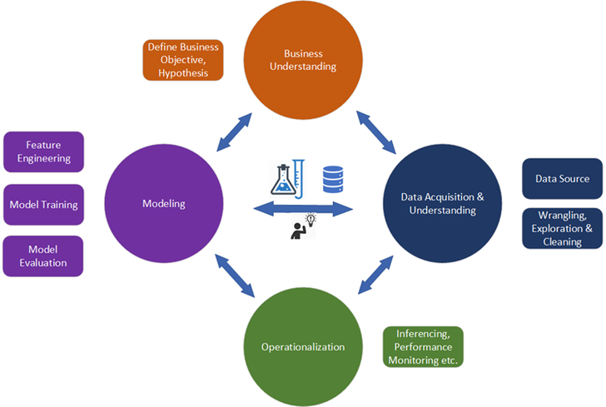
PROCESS FLOW
Business Understanding
Define Business Objective
Feature Engineering
Modelling
Data Acquisition & Understanding
Data Source
Model Training
Wrangling, Exploration and Cleaning
Model Evaluation
Operationalization
Inferencing, Performance Monitoring etc.

Slide 3
BUSINESS BACKGROUND – RETAIL ANALYTICS
According to Forbes, Ecommerce will become the largest retail channel in the world by 2021 and to cater such a major increase in the online retail and ecommerce activity retailers will need to tailor their digital strategies appropriately
Average rate of consumers who do not fulfil the process of shopping transaction is approximately 70 percent in 2010
Almost 95 percentage of internet users visit online retailers without purpose of actually making a transaction

Slide 4
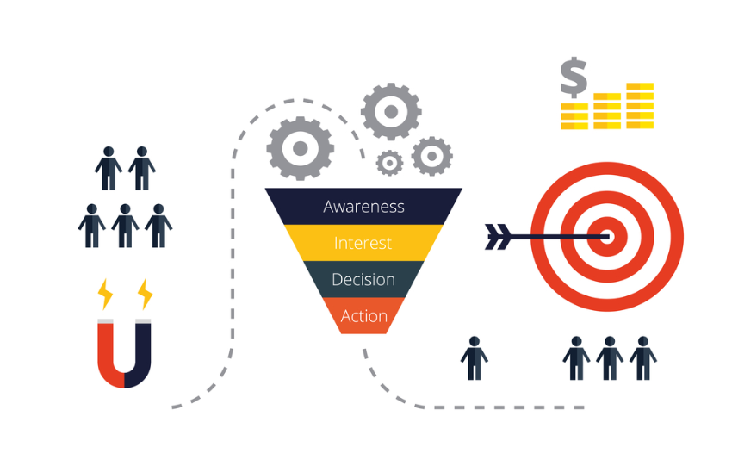

BUSINESS PROBLEM
4 Step Sales Funnel
Customer Journey Focused
Prospects
Predict the purchasing intention of the visitor using aggregated pageview data track during the visit along with some session and user information
To build the visitor behavior analysis model measuring the user’s intention to finalize the transaction
True Customers
Source: digitalmarketinginstitute.com
Columbia Sportswear Company
Turkish Gözalan Group
www.columbia.com.tr
ABOUT THE DATASET
Founded in 1938 (81 years ago)
Manufactures and distributes outerwear, sportswear, footwear, camping equipment, accessories etc.
Leading distributer of International Brands in Turkey
Became distributer of Columbia Sportswear in 2004
Domain Registered in 2008
The dataset is either of 2009 or later

Slide 5



PROJECT OVERVIEW
Upcoming Deposits
$
12,330
12,205
Attributes
18
Numerical
10
Customer Sessions
84.37% Revenue Not Generated
15.63% Revenue Generated
Categorical
8
Duplicates: 125
Imbalance Class
Target Class
Revenue
Market Location (Turkey)
Sportswear Market
The dataset was formed so that each session would belong to a different user in a 1-year period to avoid any tendency to a specific campaign, special day, user profile, or period.
Note
3.4% GROWTH*
CAGR in 5 Years
2894 Million USD
Columbia Sales in 2019

Slide 6
EXPLORATORY DATA ANALYSIS – UNIVARIATE & BIVARIATE – I
Upcoming Deposits
Though the returning visitors corresponds to ~85% of the overall sessions, but the conversion rate of new visitors is (24.93 – 14.09) ~ 10% greater than the returning visitors.

Slide 7
EXPLORATORY DATA ANALYSIS – UNIVARIATE & BIVARIATE – II
Upcoming Deposits
Most Active Months
Online Shopping on Weekend?
May | November | March | December
80.93% Active Users (Combined)
Special Days Impact?
Revenue Generation on Weekend
~90% Interactions on Non-Special Days*
 | Revenue Not Generated | Revenue Generated
Non-Weekend | 84.92% | 15.08%
Weekend | 82.55% | 17.45%
*Due to Sportswear Company

Slide 8
EXPLORATORY DATA ANALYSIS – UNIVARIATE & BIVARIATE – III
Upcoming Deposits
Most Populous Region
Most Traffic Generated Type
Most Used Operating System
Most Used Browser Type
Average Time Spent on Pages
Highest Revenue Generation
Page Types | Average Time Spent (in minutes)
Administrative | 1.36
Informational | 0.58
Product Related | 20.12
Region | Type 1
Traffic | Type 2
Operating System | Type 2
Browser | Type 2

Slide 9
EXPLORATORY DATA ANALYSIS – NUMERICAL FEATURES
Upcoming Deposits
Features | Actual Skewness | Log_T | Sqrt_T | Cbrt_T | 4thPower_T | 5th_Power_T | 6thPower_T | 7thPower_T
Administrative | 1.95 | 0.55 | 0.63 | 0.24 | 0.08 | 0 | -0.04 | -0.07
Administrative Duration | 5.59 | 0.24 | 1.53 | 0.69 | 0.37 | 0.21 | 0.12 | 0.06
Informational | 4.01 | 2.01 | 1.93 | 1.62 | 1.51 | 1.46 | 1.44 | 1.42
Informational Duration | 7.54 | 1.9 | 3.42 | 2.43 | 2.05 | 1.87 | 1.77 | 1.7
ProductRelated | 4.33 | -0.04 | 1.5 | 0.81 | 0.45 | 0.19 | -0.06 | -0.31
ProductRelated Duration | 7.25 | -1.43 | 1.41 | 0.42 | -0.21 | -0.72 | -1.17 | -1.56
BounceRates | 3.16 | 3.08 | 1.72 | 0.9 | 0.48 | 0.26 | 0.13 | 0.05
ExitRates | 2.23 | 2.13 | 1.21 | 0.69 | 0.26 | -0.17 | -0.64 | -1.15
PageValues | 6.35 | 1.79 | 2.52 | 1.89 | 1.66 | 1.54 | 1.48 | 1.44
SpecialDay | 3.29 | 3.1 | 2.86 | 2.74 | 2.7 | 2.67 | 2.66 | 2.65
Transformation
Used Sklearn’s PowerTransformer to transform the data
Scaling
Used Sklearn’s RobustScaler to scale the data

Slide 10
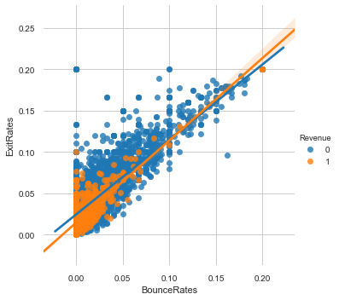
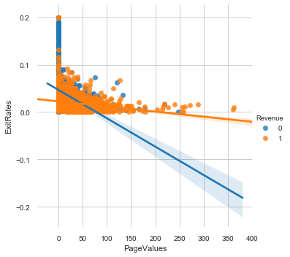
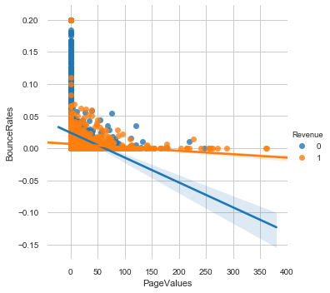
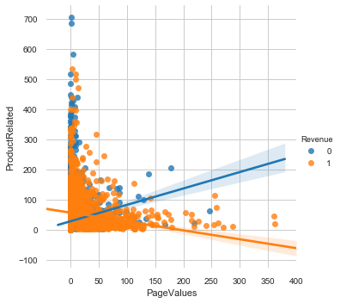
EXPLORATORY DATA ANALYSIS – MULTIVARIATE I
Exit Rates & Bounce Rates are positively correlated with the correlation coefficient of 0.90
FIG 1: Exit Rates vs Bounce Rates vs Revenue
Page Values & Exit Rates are negatively correlated. As the page value increases, exit rates decreases.
FIG 2: Page Values vs Exit Rates vs Revenue
Page Values & Bounce Rates are negatively correlated. As the page value increases, bounce rates decreases.
FIG 3: Page Values vs Bounce Rates vs Revenue
With increasing Page Values, the revenue generation is more. There are certain pages which have very less page values which need to be improved in order to generate revenue.
FIG 4: Product Related vs Page Values vs Revenue

Slide 11
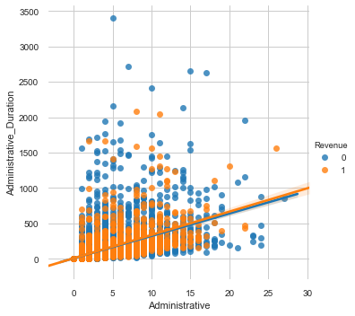
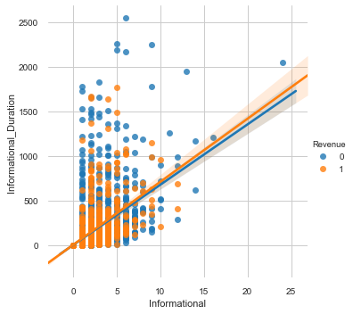
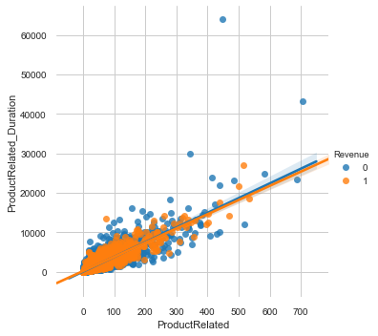
EXPLORATORY DATA ANALYSIS – MULTIVARIATE II
Administrative Pages and Administrative Duration, Informational and Informational Duration, Product Related and Product Related Duration are positively correlated.
On administrative pages 2 to 15 such as login, logout, password recovery, profile, email wish list etc., visitors have spent more than 500 seconds (approx. 8 minutes) which is generally quite higher than normal. It suggests that visitors are having trouble logging in or it’s taking too much time to process the request.
Even though customers/visitors have spent a large amount of time on product related pages but the revenue generation is very low. There are certain outliers who did spent more than 60000 seconds (approx. 17 Hours) but still didn’t make any transaction.

Slide 12
EXPLORATORY DATA ANALYSIS – Q/A
Q. Which Traffic Types have generated no Revenue?
A. Traffic Types: 12, 15, 17, & 18
Q. Which Traffic Type(s) has generated maximum Revenue?
A. Traffic Type: 2
Q. Which Traffic Types have generated high bounce rate and what is the overall Revenue generation from those Traffic Types?
A. Traffic Types: 11 (2), 20 (1), and 8 (1)
Traffic types 11, 20, and 8 accounts for 24.52% of the overall revenue generation.
Bounce rate can be wildly different depending on the source of traffic. For example, it’s likely that search traffic will produce a low bounce rate while social and display traffic might produce a high bounce rate.

Slide 13
EXPLORATORY DATA ANALYSIS – Q/A
Which Traffic Types generate high exit rate and what is the overall Revenue generation from those TrafficTypes?
A. Traffic Types: 11 (1), 20 (1), and 8 (1)
Traffic types 11, 20, and 8 accounts for 24.52% of the overall revenue generation.
Q. Which Region generates high bounce rate?
A. Region 1 and 3.
Q. What are the top 3 Traffic Types of New visitors?
A. Traffic Types 2, 8 and 5.
Q. What are the maximum time spent on Administrative, Informational and ProductRelated pages and what are the page numbers?
A. 17.48 Hours were spent on the product related page number 449.
56.65 Minutes were spent on administrative page number 5.
42.49 Minutes were spent on informational page number 6.
Even though the revenue was not generated in the above case.

Slide 14
MODELLING – BEFORE SAMPLING
F1 Score
Precision
Recall
Models
Logistic Regression
89%
86%
90%
90%
90%
0.904
0.853
0.915
0.908
0.908
0.900
0.589
0.906
0.904
0.902
Decision Tree
Random Forest
Gradient Boosting
Light GBM
BU NOW
BUY NOW

Slide 15
MODELLING – AFTER SAMPLING – NEAR MISS
F1 Score
Precision
Recall
Models
Logistic Regression
81%
62%
69%
67%
68%
0.782
0.625
0.699
0.677
0.689
0.783
0.556
0.644
0.617
0.633
Decision Tree
Random Forest
Gradient Boosting
Light GBM
BU NOW
BUY NOW

Slide 16
MODELLING – AFTER SAMPLING - SMOTE
F1 Score
Precision
Recall
Models
Logistic Regression
87%
86%
90%
89%
89%
0.868
0.858
0.899
0.893
0.897
0.860
0.850
0.900
0.896
0.895
Decision Tree
Random Forest
Gradient Boosting
Light GBM
BU NOW
BUY NOW

Slide 17
THANK YOU

